Slide 1

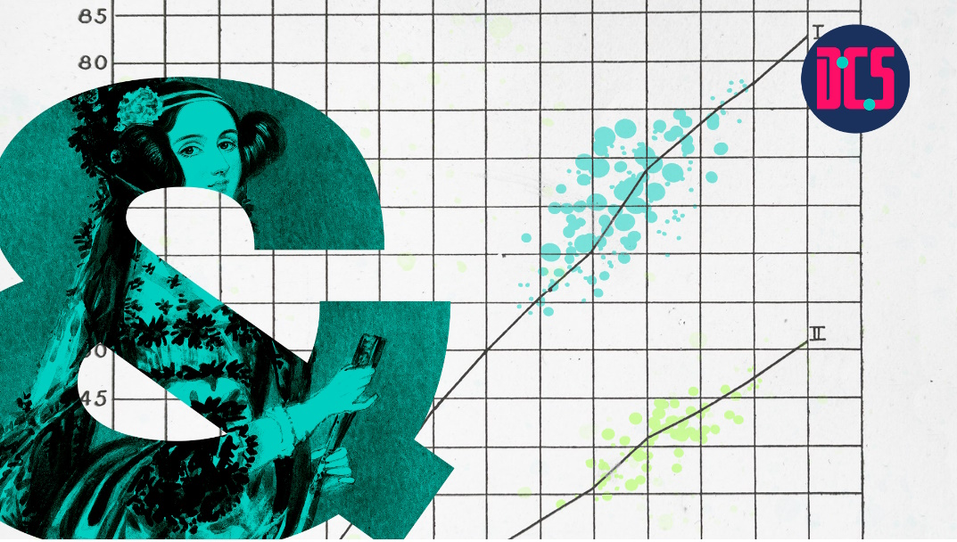
Regression & Mixed-Effects Modelling with R
Fang Jackson-Yang & Aislinn Keogh
13 May 2025

Slide 2
Course outline
Session 1. Simple Regression; Individual Difference; Intro to Linear mixed-effect models (LMMs)
Session 2. LMMs (lmer); Generalised LMMs (glmer)
Session 3. Practical
Session 4. Ggeneralised LMMs continued; Model assumptions and diagnostics
Session 5. Practical

Slide 3
Session 3 Roadmap (today)
Model Comparison & Selection
Generalised LMMs
Model Assumptions
Exercise and Q&A

Slide 4
Model Comparison and Selection

Slide 5

Recall: Structure of LMMS
R code:
lmer ($y$ ~ $x1 ∗x2$ +
( 1 + $x1 ∗x2$ | Grouping1 ) +
( 1 + $x1$ | Grouping2 ) ,
data = datafilename )
Notes:
You can have more than one source of individual differences (e.g., group by students; by schools)

Slide 6
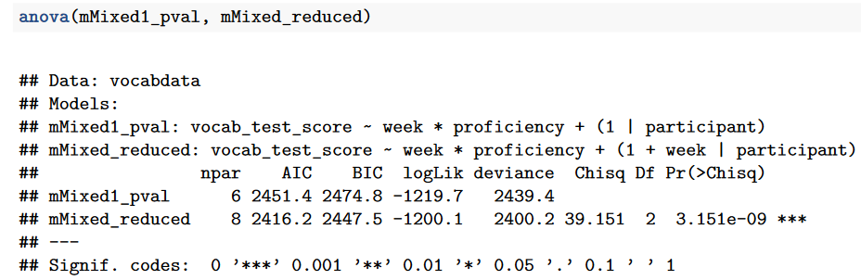

Recall: Model Fit
No $R^{2}$
Use Maximum likelihood Ratio test to compare models
R code: anova(model1, modle2)
NB: when using it to test random structures, make sure to set REML = T
Notes:
The likelihood ratio (LR) test is a test of hypothesis in which two different maximum likelihood estimates of a parameter are compared in order to decide whether to reject or not to reject a restriction on the parameter.
comparing models that differ in random effect structures is very tricky. We need to set REML=T (as the anova function automatically re-fits them with ML) or that we have large sample sizes at all levels.

Slide 7
Model Comparison & Selection
In what order should you build your models?
Which model should you select as final model?
Barr, Levy, Scheepers, & Tily, (2013) : keep it maximal
Matuschek, Kliegl, Vasishth, Baayen & Bates (2017) : make it parsimonious to balance Type1 error and power
Notes:
Type I : false-positive; rejecting null hypothesis when it is actually true

Slide 8
Common Issues
Convergence
Overfitting

Slide 9
Deal with Convergence Issue
Solutions:
Adjust stopping (convergence) tolerances for the nonlinear optimizer, using the optCtrl() argument to lmerControl.
Centre and standardise continuous predictor variables
- the scale() function
Notes:
Centering: Centering can make regression parameters more meaningful. Centering involves subtracting a constant (typically the sample mean) from every value of a predictor variable and then running the model on the centered data. Many times, it is helpful to center the data around the mean of the variable, although any logical constant can be used.
https://cscu.cornell.edu/wp-content/uploads/66_centering.pdf
‘Standardising’ predictors, by subtracting the mean and dividing by the standard deviation, is a common way to make interpreting regression models easier, and particularly to make comparisons between predictors — e.g. regarding their relative importance in predicting the outcome.
Fit the model, use the “standardize()” function from package “arm” (arm::standardize) to standardize the coefficients, this automatically scales the data for m1 and re-fits the model. https://benwhalley.github.io/just-enough-r/scaling-predictors.html
e.g. vocabdata<- scale(vocabdata$week, center=TRUE, scale=FALSE)

Slide 10
Deal with Overfitting Issue
Solutions:
Remove the most complex part of the random effects structure (i.e. random slopes)
Maybe acceptable to remove a specific random effect term when its variance estimates are very low

Slide 11
Generalised Linear Mixed-effects Models - glmer()

Slide 12
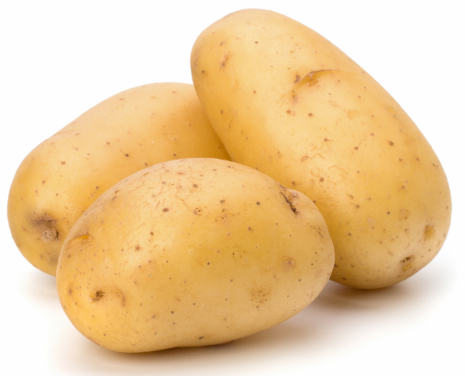
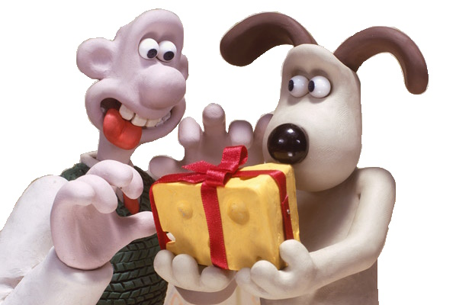
Binary Outcome
‘potato’ or
‘tattie’
Pass or Fail
Invest or Not
Vote ‘Yes’ or ‘No’
‘Correct’ or ‘incorrect’ answer
Fixation on the target image or not
Align with partner or not
Lexical choice
Grammatical choice
(a) Gromit gave Wallace some cheese.
(b) Gromit gave some cheese to Wallace.

Slide 13

Generalised Linear Mixed-effects Models
glmer () for binary outcome
R code:
glmer ( $y$ ~ $x1 ∗x2$ +
( 1 + $x1 ∗x2$ | Grouping1 ) +
( 1 + $x1$ | Grouping2 ) ,
data = datafilename,
family = ‘binomial’
)

Slide 14


Example: Lexical Choice Study
‘M8’
‘Noob’ or ‘Beginner’ ?
‘noob’
Internet slang data (simulated data)
Hypothesis: People were more likely to use internet slang words (as relative to alternative expressions) after seeing their conversational partner uses a slang rather than a stand word.
‘mate’
‘beginner’
Notes:
newbie beginner

Slide 15
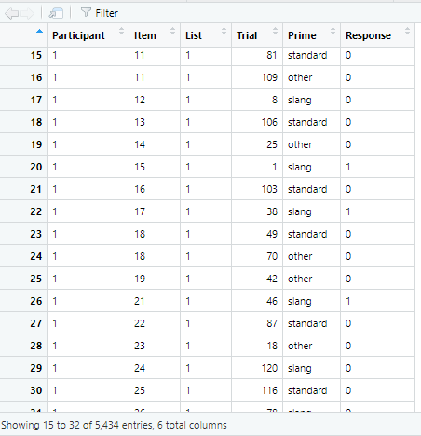
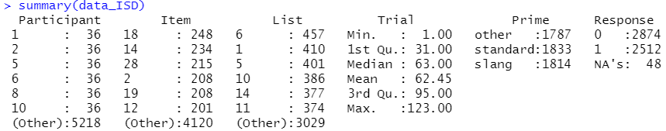
Example: Lexical Choice Study
Repeated measure (36 items/participant)
One predictor (3 conditions):
‘prime’ = slang / standard words / other
Two sources of random variance
Notes:
newbie beginner

Slide 16

Build a Glmer Model
Model <- glmer ( $response$ ~ $prime$ +
( 1 | $participant$ ) +
( 1 | $item$) ,
data = $dataISD$,
family = ‘binomial’
)

Slide 17
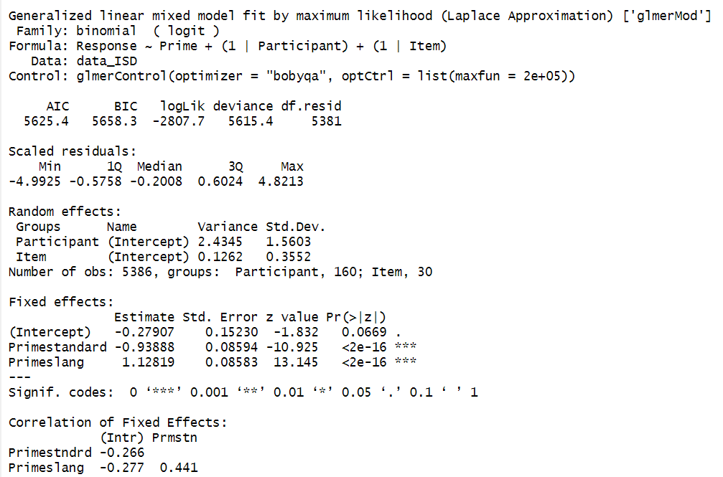
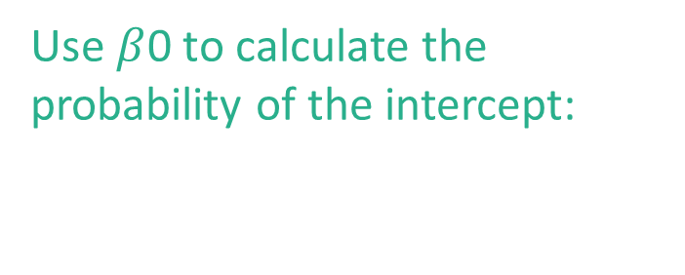
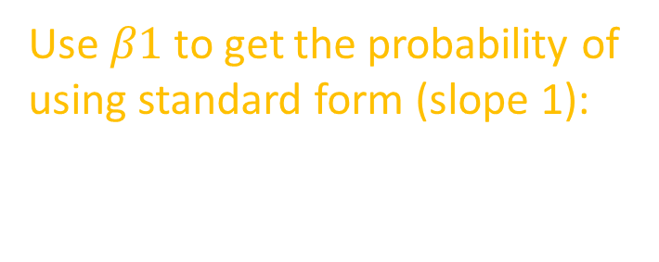
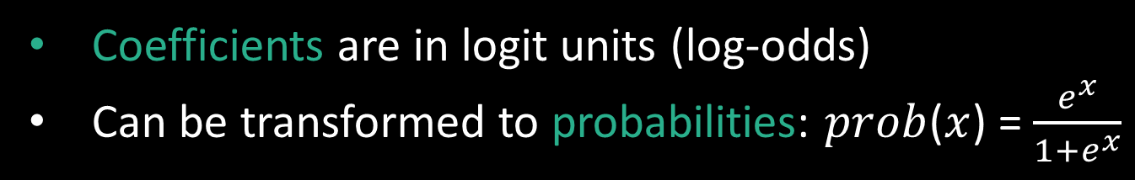
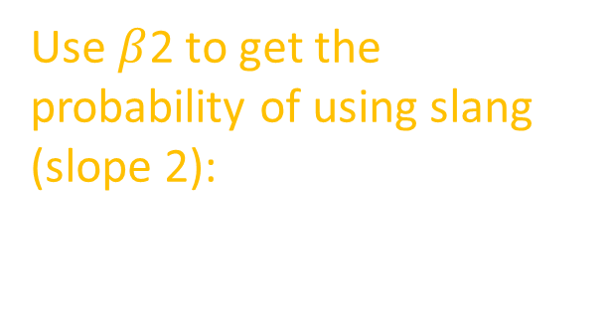
Interpret Coefficients
Use $β$0 to calculate the probability of the intercept:
$\frac{e^{−0.28}}{1+ e^{ −0.28}}$ = 0.43
Use $β1$ to get the probability of using standard form (slope 1):
$\frac{e^{(−0.28+(−0.94))}}{1+ e^{( −0.28+(−0.94))}}$ = 0.23
Use $β$2 to get the probability of using slang (slope 2):
$\frac{e^{(−0.28+1.13)}}{1+ e^{( −0.28+1.13)}}$ = 0.70
Coefficients are in logit units (log-odds)
Can be transformed to probabilities: $prob$($x$) = $\frac{e^{x}}{1+e^{x}}$

Slide 18
Model Assumptions

Slide 19
Model Assumptions: Linear regression
Nature of the model
- the relation between predictor and outcome has to be linear
Nature of the errors (i.e., residuals)
- normal and independent of each other

Slide 20
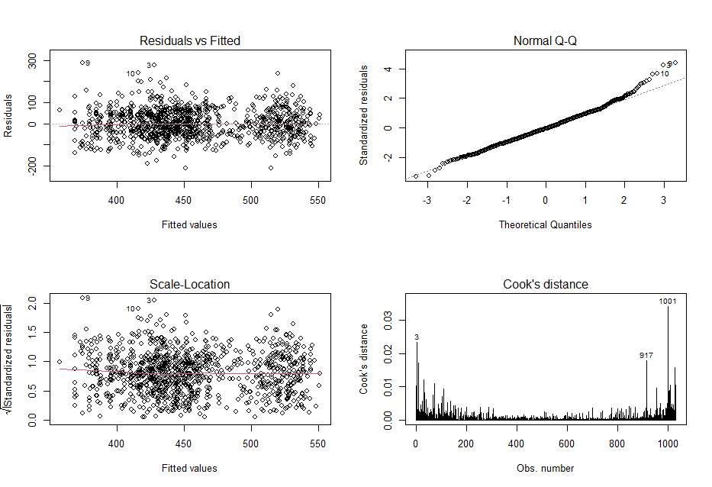
Model Assumptions: Simple regression lm()
Required(LINE):
- Linearity of relationships
- Independence of residuals
- Normality of residuals
- Equal variances for residuals
Desirable:
- uncorrelated predictors
(no collinearity)
- no outliers
Notes:
Independence of residuals: requires each residual should not be affected by other residuals; No easy way to check it, depends on the source of the observations, one determinant might be a participant observed multiple times, i.e. REPEATED measures, in which case the independence assumption is violated, mixed effect should be used
For Cook’s distance, distances over 1 are worth looking at. In general below 1 is good

Slide 21
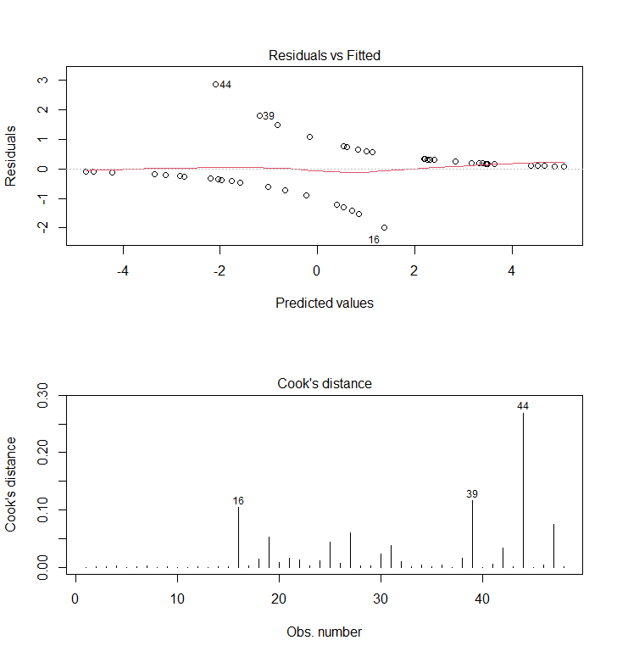
Model Assumptions: Simple regression glm()
For binomial DVs, (logistic regression)
Required:
- LINEAR relationships between IVs and log-odds
- Normality of residuals
- homogeneity of variance
- Independence of residuals
Desirable:
- uncorrelated predictors (no collinearity)
- no “bad” (overly influential) observations
- large samples (due to maximum likelihood fitting)
Notes:
For Cook’s distance, distances over 1 are worth looking at .
In general below 1 is good

Slide 22
Model Assumptions: Mixed-effects Models
Similar to simple linear regressions model
Error is random
Residuals at multiple levels
Level1 residuals: mean = 0, variance constant (R code: residual() )
Level2+ residuals: mean = 0, variance constant (R code: ranef() )

Slide 23
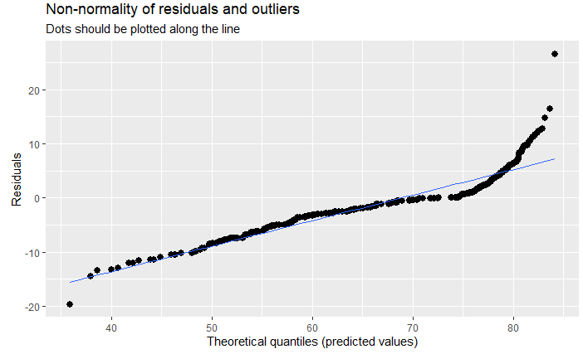
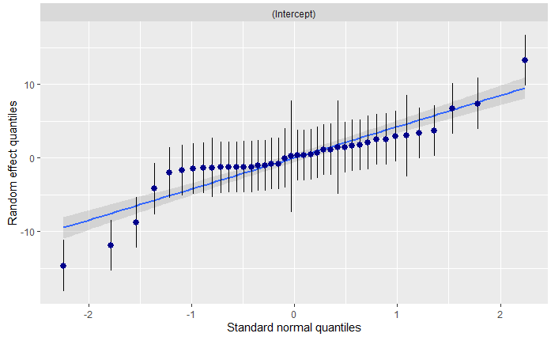
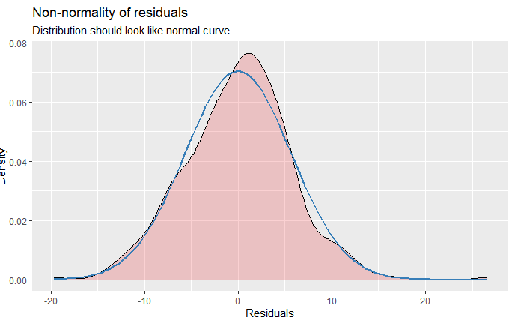
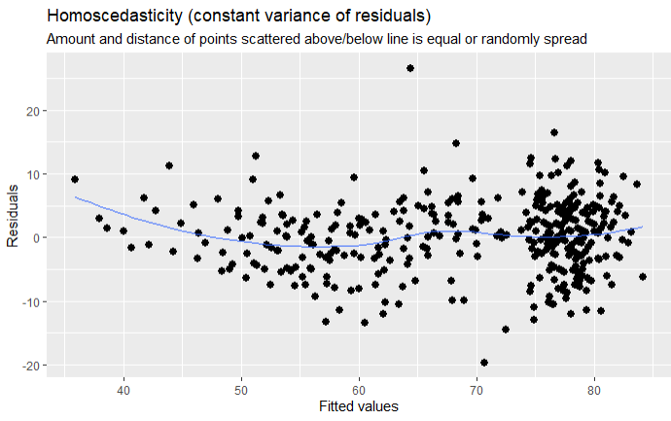
Model Assumptions: Mixed Models – lmer()
Notes:
For linear (mixed) models, this function produces plots for:
multicollinearity (i.e., check Variance Inflation Factors);
QQ-plots: checks for normal distribution of residuals and
homoscedasticity,i.e., constant variance of residuals).
Linear relationship
Independence of residuals
Homoscedasiticity :Equal variance: constant variance of residual, i.e., amount and distance of points scattered above/below line should be equal
e: constant variance of residual, i.e., amount and distance of points scattered above/below line should be equal

Slide 24
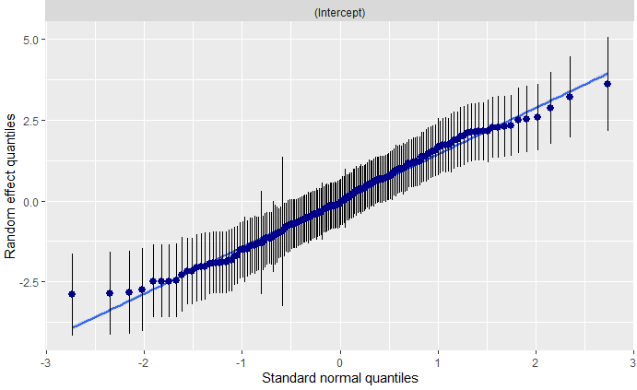
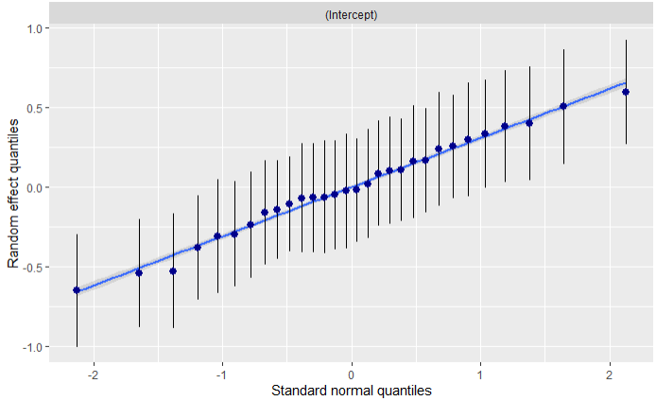
Model Assumptions: Mixed Models – glmer()
Notes:
For generalized linear mixed models, this function produces plots for the QQ-plot for random effects.

Slide 25
Exercise & Q&A

Slide 26

Exercise for Friday
The ‘cheese data’: Simulated data based on real psycholinguistic findings on structural priming.
Two Predictors :
2-level factor “Prime”
(a): Tom gave Spike some flowers.
(b): Tom gave some flowers to Spike.
2-level factor “communication” (video- vs audio-call)
Binary outcome: (a) or (b)?
(a) Gromit gave … (Wallace some cheese)
(b) Gromit gave … (some cheese to Wallace).

Slide 27


Exercise
R code:
glmer ( $y$ ~ $x1 ∗x2$ +
( 1 + $x1 ∗x2$ | Grouping1 ) +
( 1 + $x1$ | Grouping2 ) ,
data = datafilename,
family = ‘binomial’
)
Can you investigate the priming effect in the ‘cheese data’?

Slide 28
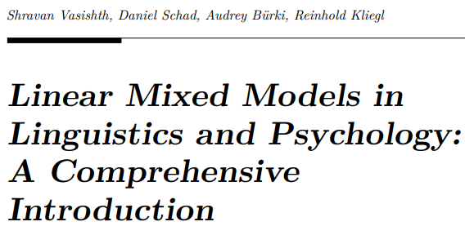
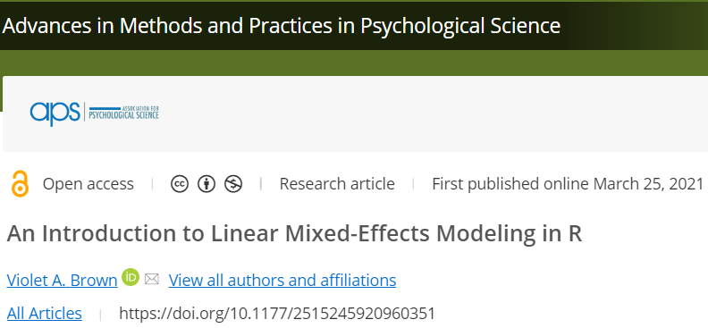
Further Reading
Paper
Brown, VA. (2021). An Introduction to Linear Mixed-Effects Modeling in R. Advances in Methods and Practices in Psychological Science. 4(1). doi:10.1177/2515245920960351
E-Book
https://vasishth.github.io/Freq_CogSci/

Slide 29

THANK YOU

